Slide 1



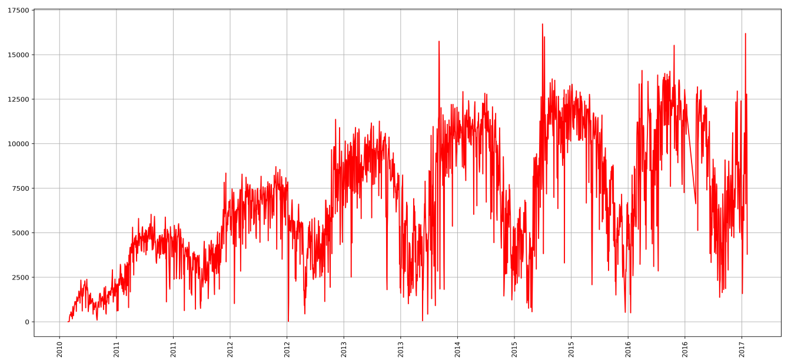
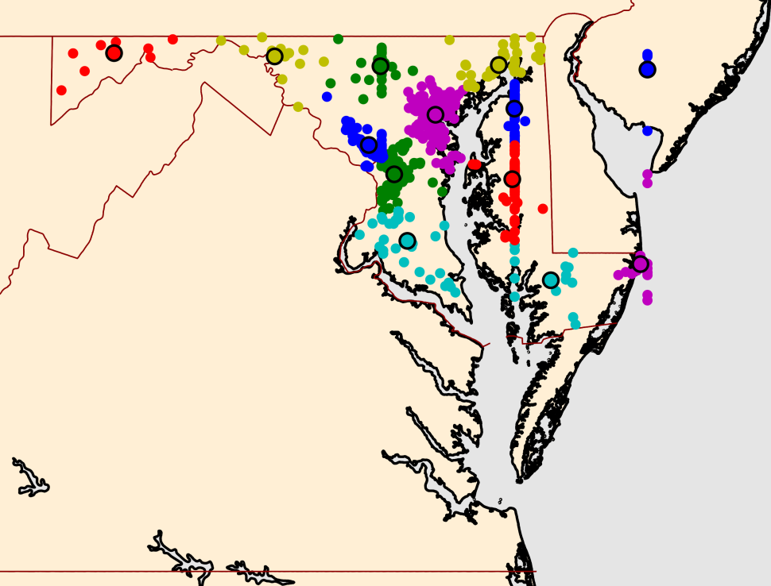
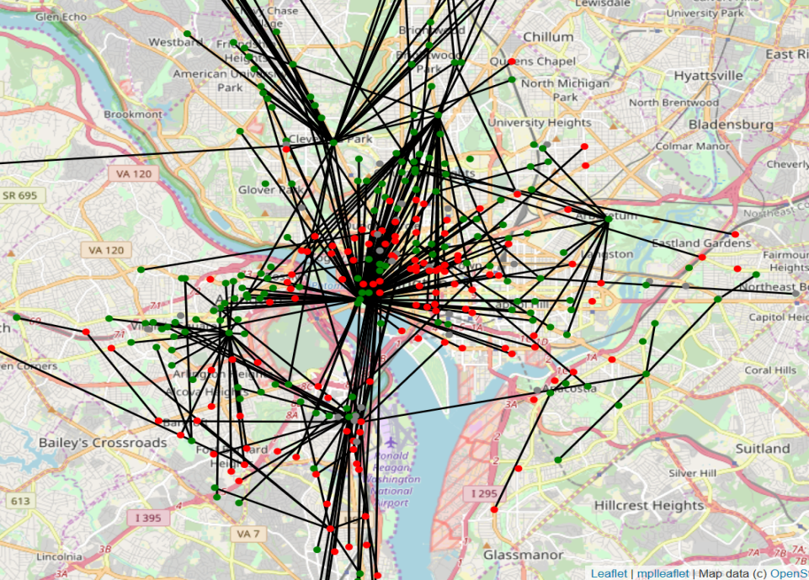
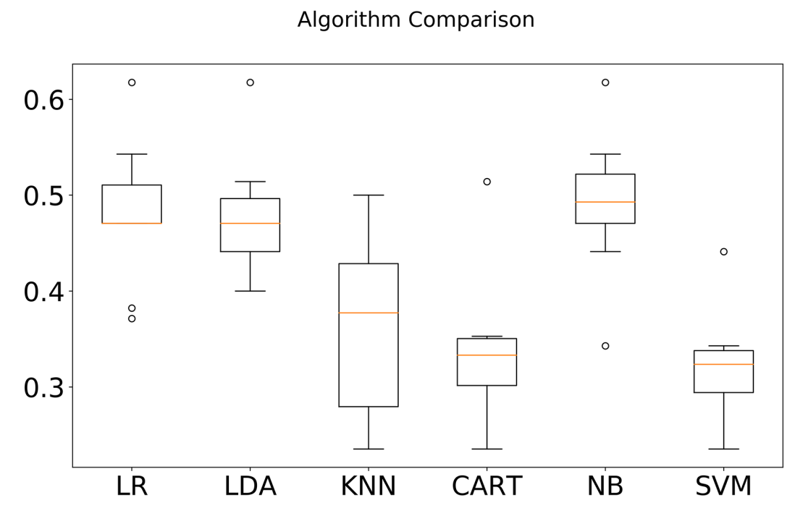
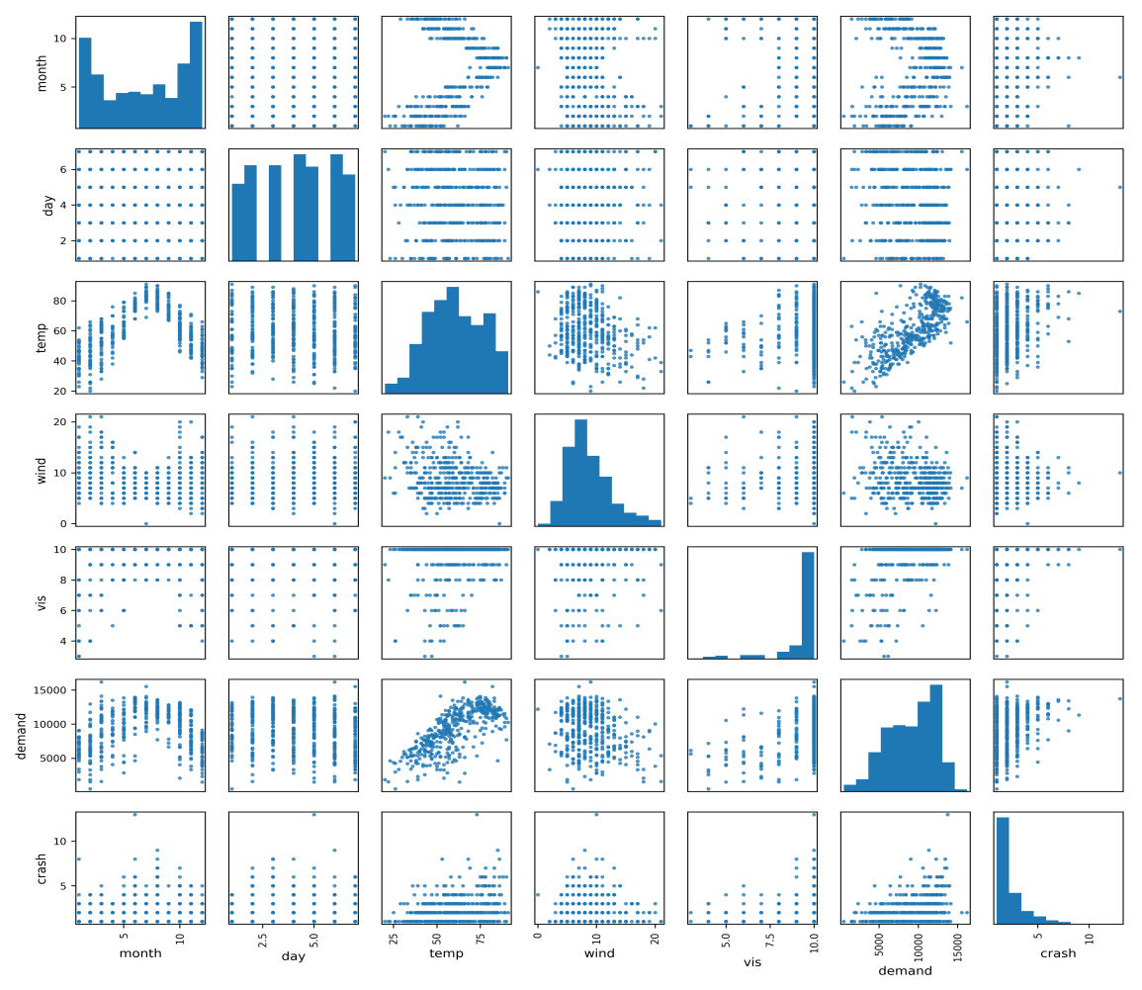
Weather and Safety Impact on Bike-Share, Case Study on Capital Bike Share, DC
Kamol Roy¹, Md Mehedi Hasnat¹ and Kwanghee Won², ¹University of Central Florida, ² University of Nebraska-Lincoln
Objective
Data Visualization
Classification of Number of Fatal Crash
Find the effects of Environmental Variables on the Bike Share Demands
Understand the Safety Issues (i.e. Fatal Bike Crashes) with Bike Demand
Demand Trend
The Demand increases over time
Seasonal variation over the years
Fatal Crash Cluster:
11830, Augustine Harman Highway
2008, Beaver Road, Hyattsville
818 LDA lane, Lonaconing
Data Set
Capital Bike Share Data. From 2010 to 2016.
Bike Share Data set contains:
Trip start and end address
Trip Start and End time
Number of bikes rented or Demand
Weather data containing:
Temperature
Wind Speed
Visibility
Rainfall
Crash Data (FARS data set) containing:
Number of fatal bike crashes
Fatalities in the crash
Location of the crash
Three Classes:
1 fatality
2 fatality
3 or more fatality
Attraction Centers: Red Points with higher number of returns than rent
Production Center: Green points with higher number of rents than return
Classification Methods:
Logistic Regression
Linear Discriminant Analysis
K-Nearest Neighbor
CART
Naïve Bayes
Support Vector Machine
Demand Prediction
LR performs best among all the classifiers.
Methodology
Correlation Matrix of Variables:
Demand and Temperature is positively correlated.
Crash and Demand is slightly correlated
Conclusions
Demand Estimation using Linear Regression:
Demand = β₁ (Temperature) + β₂ (Visibility) + β₃ (Rain fall) + β₄ (Wind Speed) + β₅ (Weekday or Weekend) + β₆ (Month)
Classification Number Fatal Crashes:
Temperature, Wind, Rain Fall and Visibility, all are important factors in predicting the bike ride demand
Clusters of Fatal Bike crashes show the locations with greater threats. The authorities can focus on improving the safety features on the locations with higher number of fatal crashes and/or fatalities.
Classification techniques can predict the extent of fatal crashes given the whether, time (day of week, month of year) and demand. Based on this authorities can:
Increase awareness about bike ride in extreme weather
Implement safety measures based on demand of stations.
Features:
Month | Day
Temperature | Wind Speed
Rain Fall | Visibility
Demand
Significant Features
Parameter | Coefficient (β) | T-stats
Temperature | 132.118 | 21.306
Wind | -79.423 | -2.953
Visibility | 469.091 | 5.921
Rain Fall | -3200 | -6.371
Notes:
Content boxes should have 0.2” of white space between all other boarders, except bottom Gold line (0.1”).

